Slide 1
Programming for problem solving
Presented by,
Devipriya M
Assistant professor
SRM IST Trichy

Slide 2
Functions
A function is a block of statements that performs a specific task.
Let’s say you are writing a C program and you need to perform a same task in that program more than once. In such case you have two options:
a) Use the same set of statements every time you want to perform the task.
b) Create a function to perform that task, and just call it every time you need to perform that task.

Slide 3
Need for functions
Functions are used because of following reasons – a) To improve the readability of code. b) Improves the reusability of the code, same function can be used in any program rather than writing the same code from scratch. c) Debugging of the code would be easier if you use functions, as errors are easy to be traced. d) Reduces the size of the code, duplicate set of statements are replaced by function calls.

Slide 4
Types of functions
1) Predefined standard library functions
Standard library functions are also known as built-in functions. Functions such as puts(), gets(), printf(), scanf() etc are standard library functions. These functions are already defined in header files (files with .h extensions are called header files such as stdio.h), so we just call them whenever there is a need to use them.
2) User Defined functions
The functions that we create in a program are known as user defined functions or in other words you can say that a function created by user is known as user defined function.

Slide 5
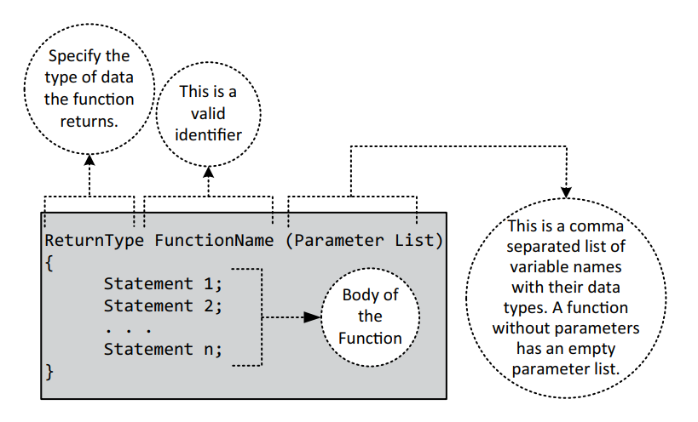
Function syntax

Slide 6
Need for functions
The concept of modular programming: that is, we can divide a bigger problem into smaller problems, and all smaller problems can be developed individually and used whenever necessary.
Reduction in the program size.
Debugging is easy.
Code reusability.

Slide 7
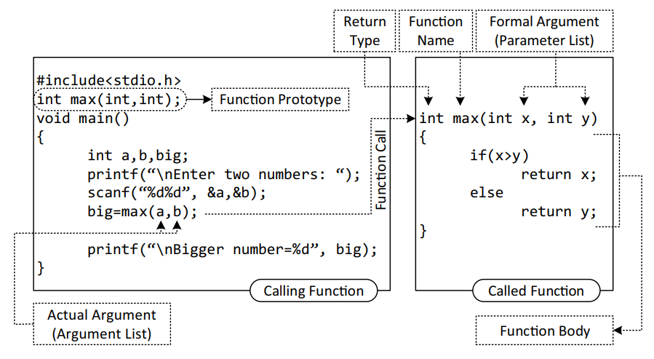
Function components: example

Slide 8
Function components
Calling Function
The function which calls other functions is known as the calling function. Here, the main() function is the calling function because it calls the function max().
Called Function
The function which is called by other functions is known as a called function. Here max() function is the called function.

Slide 9
Function components
Function Prototype
A function prototype is called the declaration of a function. We know that any variable or identifier must be declared before it is used inside the program. As the function is also an identifier, it should be declared before it is used. Hence, the declaration of the function is known as a function prototype.
A function prototype provides the following information to the compiler:
The name of the function;
The type of the value returned by the function;
The number and the type of arguments that are passed in a call to the function.

Slide 10
Function components
The prototype declaration should be done before the function main(), and it should end with a semicolon. The prototype declaration can be eliminated by defining the function before calling it. In the above example, if we write the max() function above the main() function then prototype declaration is not required.
If the function definition is present before the main() function then a prototype is not required.

Slide 11
Function components
Function Definition
The function itself is referred to as a function definition. The first line of the function definition is known as the function declarator and is followed by the function body.
Function Call
A function is a dormant entity, which comes to life only when a call to the function is made.
A function call is specified by the function name followed by the arguments enclosed in parentheses and terminated by semicolon.
c= max (a, b); invokes the function max().

Slide 12
Function Components
Actual Arguments
The arguments which are specified in the function call are known as actual arguments. In example, a and b are the actual arguments.
Formal Arguments
The parameters specified in the function definition are known as formal parameters. In example, x and y are the formal parameters.

Slide 13
Function components
Return Type
The function may return integer, char, float, etc. When the function does not return anything then we use the void keyword. In this example, the function returns an integer. The calling function must be able to receive the value returned by the called function. In the program, the variable c is used to receive the value returned by the function max().

Slide 14
Categories of a Function
A function can takes different forms. In this section we are going to discuss the different ways a function can be written.
A Function Without Arguments and Without Return Types
This format of the function has no return type, that is, the return type will be void; also these functions do not take any arguments.
A Function Without Arguments and With Return Types
Sometimes the function does not take any arguments, but it may return a value.

Slide 15
Categories of a function
A Function With Arguments and Without Return Types
A function may take some value from the calling function as an argument but may not return any value.
A Function With Arguments and With Return Types
The most used format in the categories of function is "with arguments and with return types." In this type, a function takes some argument from the calling function and returns a value to the calling function.

Slide 16
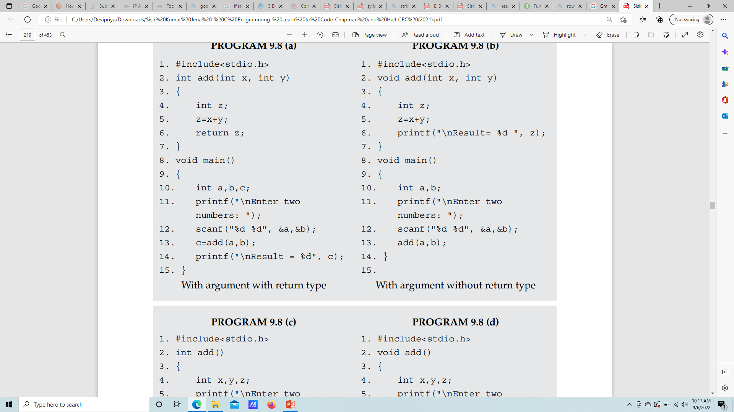
With argument with return type

Slide 17
With argument without return type

Slide 18
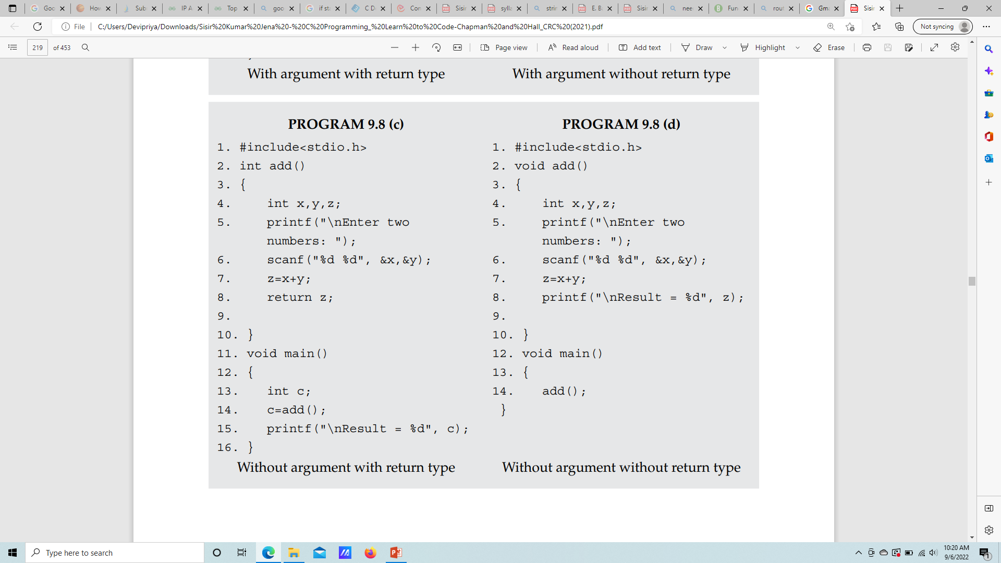
Without argument with return type

Slide 19
Without argument without return type

Slide 20
Passing parameters
The parameters of functions can be passed in two ways:
Call by value: A copy of the variable is passed to the function.
Call by reference: An address of the variable is passed to the function.

Slide 21
Call by value
In this type, the value of actual arguments is passed to the formal arguments and operation is done on the formal arguments.
Any change in the formal argument made does not affect the actual arguments because formal arguments are the photocopy of the actual argument.
Hence, when a function is called by the call by value method, it does not affect the actual contents of the arguments.
Changes made in the formal arguments are local to the block of the called function. Once control returns back to the calling function, changes made vanish.

Slide 22
Call by value
int main()
{
int x,y,change (int, int);
clrscr();
printf(“\n Enter Values of x & y :”);
scanf(“%d %d”,&x,&y);
change(x,y);
printf(“\n In main() x=%d y=%d”,x,y);
return 0;
}
change(int a, int b)
{
int k;
k=a;
a=b;
b=k;
printf(“\n In Change() x=%d y=%d”,a,b);
}
OUTPUT:
Enter Values of x & y : 5 4
In Change() x=4 y=5
In main() x=5 y=4

Slide 23
Call by reference
In this type, instead of passing values, addresses (reference) are passed.
Function operates on addresses rather than values. Here, the formal arguments are pointers to the actual argument.
In this type, formal arguments point to the actual argument. Hence, changes made in the argument are permanent.

Slide 24
Call by reference
int main()
{
int x,y,change (int*, int*);
clrscr();
printf(“\n Enter Values of X & Y :”);
scanf(“%d %d”,&x,&y);
change(&x,&y);
printf(“\n In main() X=%d Y=%d”,x,y);
return 0;
}
change(int *a, int *b)
{
int *k;
*k=*a;
*a=*b;
*b=*k;
printf(“\n In Change() X=%d Y=%d”,*a,*b);
}
OUTPUT:
Enter Values of X & Y : 5 4
In Change() X=4 Y=5
In main() X=4 Y=5

Slide 25
Call by reference
#include<stdio.h>
void div(int a, int b, float *quotient, int *remainder) {
*quotient = a / b;
*remainder = a % b;
}
main() {
int a = 76, b = 10;
float q;
int r;
div(a, b, &q, &r);
printf("Quotient is: %f Remainder is: %d", q, r);
}
Output:
Quotient is: 7.000000 Remainder is: 6

Slide 26
Function that return a pointer
#include <stdio.h>
int * buildarray() {
static int r[10];
int i;
for ( i = 0; i < 10; ++i) {
scanf("%d", &r[i]);
}
return r;
}
int main () {
int *p;
int i;
p = buildarray();
for ( i = 0; i < 10; i++ ) {
printf( "*(p + %d) : %d\n", i, *(p + i));
}
return 0;
}

Slide 27
Passing single dimension array to a function
#include <stdio.h>
float calculateSum(float num[]);
int main() {
float result, num[] = {23.4, 55, 22.6, 3, 40.5, 18};
// num array is passed to calculateSum()
result = calculateSum(num);
printf("Result = %.2f", result);
return 0;
}
float calculateSum(float a[]) {
float sum = 0.0; int i;
for (i = 0; i < 6; ++i) {
sum += a[i];
}
return sum;
}
Output:
Result = 162.50

Slide 28
Passing individual element of array
#include<stdio.h>
void printElement(int element, int index) {
printf("Element at index %d = %d \n", index, element);
}
int main() {
int arr[5] = {2, 4, 5}, i;
for (i = 0; i < 3; i++) {
printElement(arr[i], i);
}
return 0;
}
Output:
Element at index 0 = 2
Element at index 1 = 4
Element at index 2 = 5

Slide 29
Passing 2 dimension array to a function
#include <stdio.h>
void displayNumbers(int num[2][2]);
int main() {
int num[2][2];
int i, j;
printf("Enter 4 numbers:\n");
for (i = 0; i < 2; ++i) {
for (j = 0; j < 2; ++j) {
scanf("%d", &num[i][j]);
}
}
displayNumbers(num);
return 0;
}
void displayNumbers(int num[2][2]) {
int i, j;
printf("Displaying:\n");
for (i = 0; i < 2; ++i) {
for (j = 0; j < 2; ++j) {
printf("%d\n", num[i][j]);
}
}
}

Slide 30
Function Pointer
we can create a pointer pointing to a function.
The code of a function always resides in memory, which means that the function has some address.
We can store the address of memory of a function by using the function pointer.
You have to remember that the parentheses around (*function_name) are important because without them, the compiler will think the function_name is returning a pointer of return_type.

Slide 31
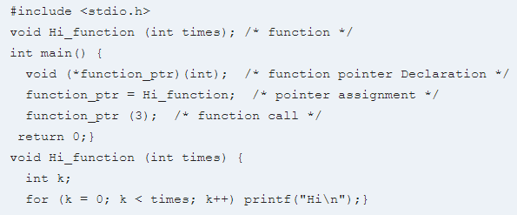
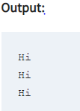
Function Pointer

Slide 32

Function Pointer
printf("Enter two integer numbers: ");
scanf("%d%d", &x, &y);
printf("Enter 0 to sum, 1 to subtract, 2 to multiply, or 3 to divide: ");
scanf("%d", &choice);
result = ope[choice](x, y);
printf("%d", result);
return 0;}
int sum(int x, int y) {return(x + y);}
int sub(int x, int y) {return(x - y);}
int mult(int x, int y) {return(x * y);}
int div(int x, int y) {if (y != 0) return (x / y); else return 0;}
#include <stdio.h>
int sum(int num1, int num2);
int sub(int num1, int num2);
int mult(int num1, int num2);
int div(int num1, int num2);
int main()
{ int x, y, choice, result;
int (*ope[4])(int, int);
ope[0] = sum;
ope[1] = sub;
ope[2] = mult;
ope[3] = div;
printf("Enter two integer numbers: ");
scanf("%d%d", &x, &y);

